Slide 1
What makes human beings unique?
UNIT A
Dreaming of the future!
Notes:
In the speaker notes you find easy-to-consult short sentences that sum up the instructions presented in the Lesson Plan.

Slide 2
ACTIVITY A1
Discussion Time
Notes:
Tell pupils that they are going to discuss a theme together.

Slide 3
ACTIVITY A1
OBSERVE THE FOLLOWING IMAGES
Notes:
Allow pupils to observe the images and ask them to describe what they see with their own words.

Slide 4
ACTIVITY A1
Have you ever tried the things featured in these pictures?
Notes:
Ask pupils to discuss the images by answering the questions present on the slide.
Expected Answer: “Yes”.

Slide 5
ACTIVITY A1
Did these things already exist
200 years ago?
Notes:
Ask pupils to discuss the images by answering the questions present on the slide.
Expected Answer: “No”.

Slide 6
ACTIVITY A1
Do these things naturally occur or are they human-made?
Notes:
Ask pupils to discuss the images by answering the questions present on the slide.
Expected Answer: “They are human-made - They are inventions.”.

Slide 7
ACTIVITY A1
What characteristics do inventors have that allowed them to create these?
Notes:
Ask pupils to discuss the images by answering the questions present on the slide.
Expected Answer: “Humans can imagine, think, create, plan and dream.”.

Slide 8
ACTIVITY A1
Activity Time
Write these characteristics on your Student Sheet!
Notes:
Ask pupils to write them down on the activity #A1.1 in the student sheet.

Slide 9
Summarizing…
ACTIVITY A1
Humans can build houses, create tools, communicate…
Humans can speak complex languages, solve difficult problems and modify their surroundings!
Humans can imagine, dream, think, create and plan!
Notes:
Summarise the discussion highlighting the characteristics

Slide 10
Let’s use these unique traits to be inventors?
ACTIVITY A2
Notes:
Challenge pupils to use the traits they identified in the previous activity to become “inventors”

Slide 11
Creativity Time!
Choose a school or household issue that could be solved with a machine/device
Let’s form Teams of 4
ACTIVITY A2
Draw the prototype on your student sheet
Tip: To help your team choose an issue and prototype,
answer the questions on your student sheet
Notes:
Introduce pupils for the activity by reading the instructions.

Slide 12
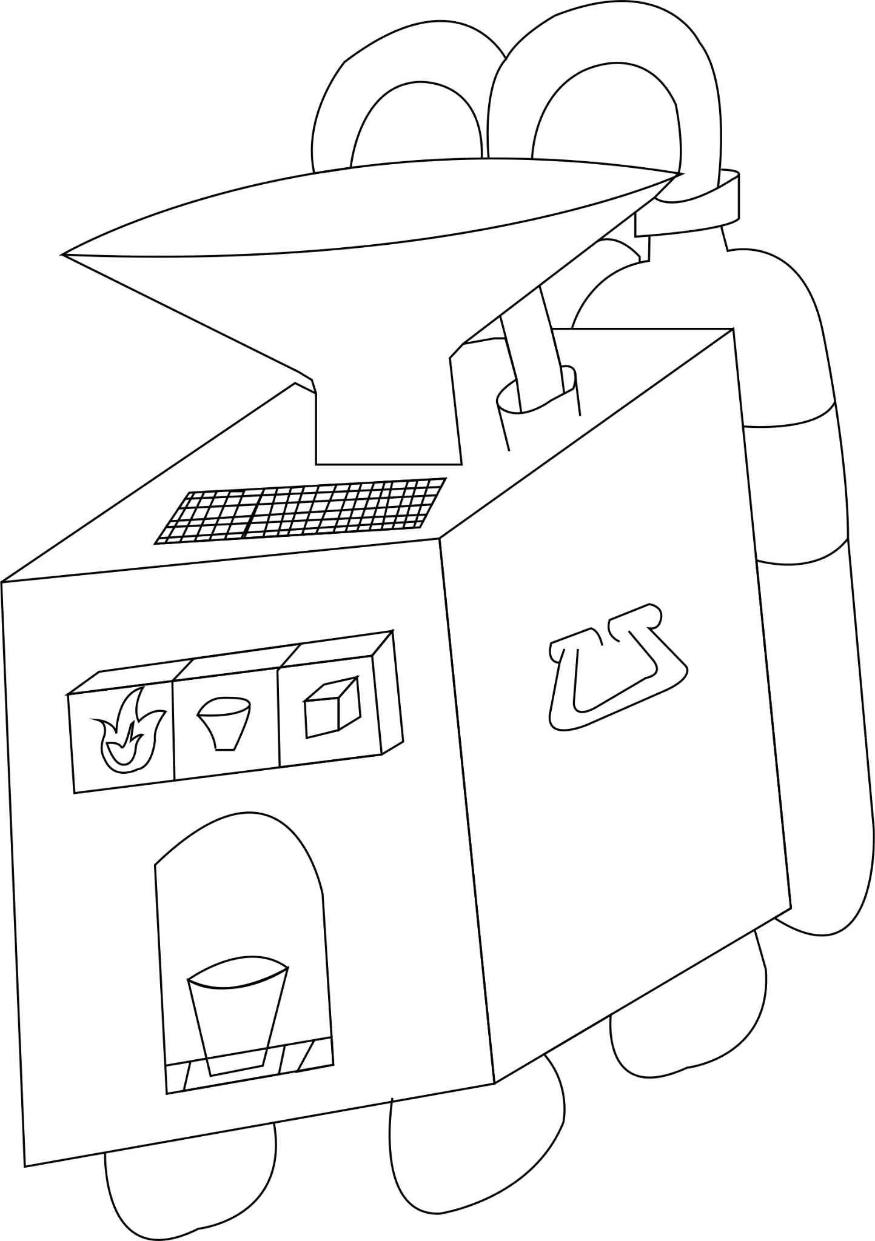
Prototype Example
W-O’-TRON 2000
Notes:
Show the prototype example.

Slide 13
Sharing Time!
ACTIVITY A3
Notes:
Organise the prototype presentation of each team.

Slide 14
Voting Time!
ACTIVITY A3
What invention was the most useful?
What invention was the most creative?
Notes:
Organise a poll to identify the “most useful” and “most creative” prototype.

Slide 15
Conclusion
MAIN MESSAGES
Humans are capable of solving complex problems and modify
the environment to their advantage
All humans have the ability to become inventors, if they wish to
What is the most interesting thing you have learned from this lesson?
Notes:
Reiterate the key messages and ask pupils what skills they have used to design their prototype. Invite them to write down what they have learnt with this lesson on the student sheet.

